Slide 1
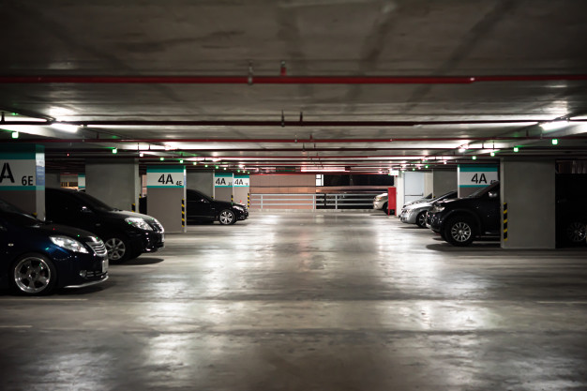
Title: Eazy Parking – (A Online Parking Sharing & Service Platform)

Slide 2
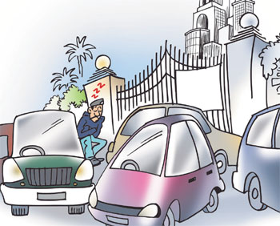
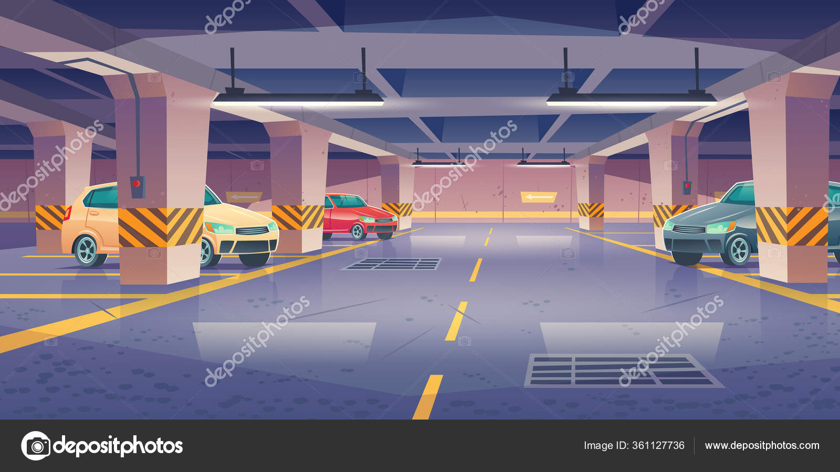
Project Members
Khalid Al Hassan – 1821505642
Aman Bin Azad (Nafiz) – 2011173642
Md. Touhidur Rahman – 2011873042
Faria Naznin - 1931198042

Slide 3
Project general description
Eazy Parking is an online parking and sharing service platform . With the help of Eazy parking vehicles owner can park their vehicles with safety and any hardship .Also the garage owners also gets the change to earn some money by renting their garages.

Slide 4
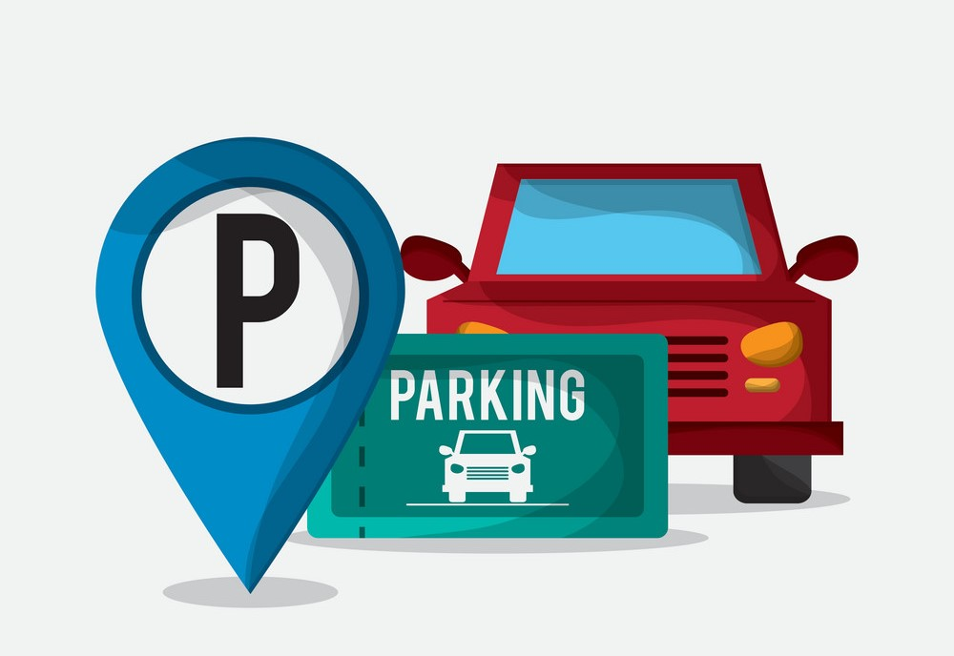
Does the project have a clear target market or audience?
Yes , Anyone aged 18 or above and have vehicle but faces issues regarding their vehicle parking and safety are the main target or audience in this market.

Slide 5
Problems and Opportunity
Car parking are now a days great problem as the road areas are dense and cannot supply sufficient space for parking as well as security of the vehicles
are of great concern.
So, we introduce Eazy Parking. A online parking and sharing service platform. Where vehicle owner need not to stress anymore about their vehicle parking and security. As well as garage owners can also make a profit out of their garage.

Slide 6
List of functionality
Car owners and garage owners will register with the system.
Car owner's perspective:
1. Car owners can see the available parking spot, slots and fair.
2. Can also reserve the available spots and slots.
Garage owners' perspective:
1. Garage owners will add available parking spots, slots and fairs.
2. They can also view how many cars have been booked in his garage. And how many slots are available for the users.

